Slide 1
Classifier Evaluation and Improvement Techniques

Slide 2
Classifier Evaluation
Estimate how accurately the classifier can predict on future data on which the classifier has not been trained
Compare the performance of classifiers if there are more than one
How to estimate accuracy?
Are some measures of a classifier’s accuracy more appropriate than others?

Slide 3
Classifier Evaluation Metrics
Confusion Matrix
Confusion between the positive and
Predicted class
negative class
Actual class
Positive tuples ‐ tuples of the main class of interest
Negative tuples ‐ all other tuples
Confusion matrix – a tool for analysing how well a classifier can recognize tuples of different classes
True positives (TP) ‐ positive tuples correctly labeled by the classifier
True negatives (TN) ‐ negative tuples correctly labeled by the classifier
False positives (FP) ‐ negative tuples incorrectly labeled as positive
False negatives (FN) ‐ positive tuples mislabeled as negative
Confusion matrices can be easily drawn for multiple classes
 | C₁ | ¬ C₁
C₁ | True Positives (TP) | False Negatives (FN)
¬ C₁ | False Positives (FP) | True Negatives (TN)

Slide 4
Classifier Evaluation Metrics
Classifier Accuracy, or recognition rate: percentage of test set tuples that are correctly classified
Accuracy = (TP + TN)/All
Error rate: 1 – accuracy, or
Error rate = (FP + FN)/All
Sensitivity (Recall): True Positive recognition rate
Sensitivity = TP/P
Specificity: True Negative recognition rate
Specificity = TN/N
A\P | C | ¬C
C | TP | FN | P
¬C | FP | TN | N
 | P’ | N’ | All

Slide 5
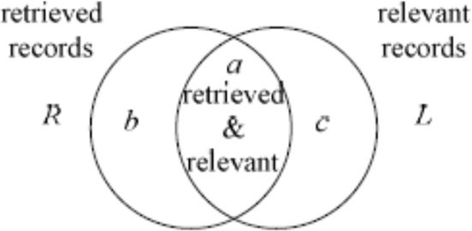

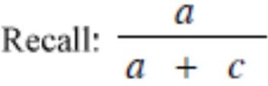
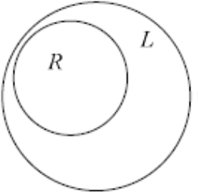
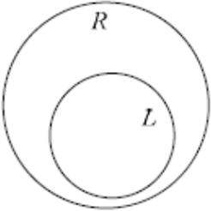
Classifier Evaluation Metrics
Precision: exactness – what % of tuples that the classifier
labeled as positive are actually positive
# positive tuples retrieved
A\P | C | ¬C
C | TP | FN | P
¬C | FP | TN | N
 | P’ | N’ | All
Precision =
# tuples retrieved
TP TP + FP
=
Recall: completeness – what % of positive tuples did the classifier label as positive?
# positive tuples retrieved
Recall =
# positive tuples
₌ TP P
Precision = 1
Recall = 1

Slide 6
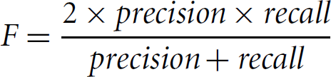
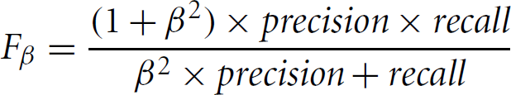
Classifier Evaluation Metrics
F measure (F₁ or F‐score): harmonic mean of precision and recall
F_{ß}: weighted measure of precision and recall
– assigns ß times as much weight to recall as to precision

Slide 7
Classifier Evaluation Metrics
Example of Confusion Matrix:
Predicted class
 | buy_computer = yes | buy_computer = no | Total
buy_computer = yes | 6954 | 46 | 7000
buy_computer = no | 412 | 2588 | 3000
Total | 7366 | 2634 | 10000
Actual class

Slide 8
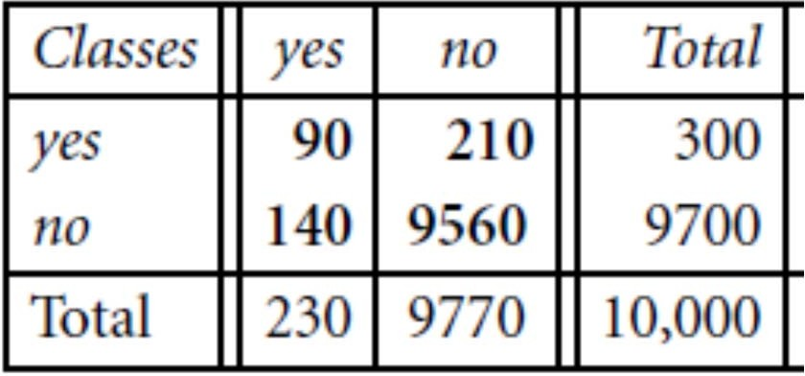
Classifier Evaluation Metrics
Predicted class
Classify medical data tuples
Positive tuples (cancer = yes)
Negative tuples (cancer = no)
The classifier seems quite accurate; 96.5% accuracy
Sensitivity = TP/P = 90/300×100 = 30% (accuracy on the cancer tuples)
Specificity = TN/N = 9560/9700×100 = 98.56% (accuracy on noncancer tuples)
Classifier is correctly labeling only the noncancer tuples and misclassifying most of the cancer tuples!!!
Accuracy rate of 98.56% is not acceptable
Only 3% of the training set are cancer tuples
Actual class

Slide 9
Overfitting and Underfitting
Overall goal in machine learning is to obtain a model/ hypothesis that generalizes well to new, unseen data
Goal is not to memorize the training data (far more efficient ways to store data than inside a random forest)
A good model has a “high generalization accuracy” or “low generalization error”
Assumptions we generally make are:
i.i.d. assumption: inputs are independent, and training and test examples are identically distributed (drawn from the same probability distribution)
For some random model that has not been fit to the training set, we expect both the training and test error to be equal

Slide 10
Overfitting and Underfitting
In statistics, a fit refers to how well a target function is approximated
Overfitting refers to a model that models the training data too well
Model learns the detail and noise/ random fluctuations in the training data as concepts
These concepts do not apply to new data; negatively impacts the performance
More likely with nonparametric and nonlinear models that have more flexibility when learning a target function
Example: decision trees
Techniques to reduce overfitting:
Reduce model complexity
Regularization, Early stopping during the training phase
Cross‐validation

Slide 11
Overfitting and Underfitting
Underfitting refers to a model that can neither model the training data nor generalize to new data
Model cannot capture the underlying trend of the data
Usually happens when:
we have less data to build an accurate model
we try to build a linear model with a non‐linear data
Techniques to reduce underfitting :
Increase training data
Increase model complexity
Increase number of features, performing feature engineering
Increase number of epochs/duration of training

Slide 12
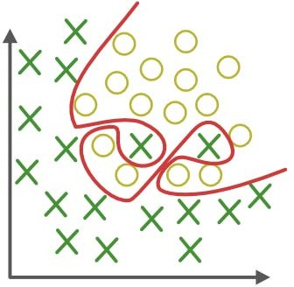
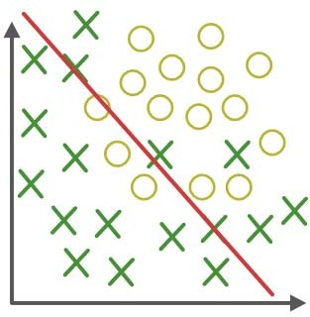
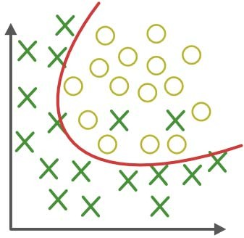
Overfitting and Underfitting
Overfitting
Underfitting
Appropriate‐fitting
Forcefitting – too good to be true
Too simple to explain the variance

Slide 13
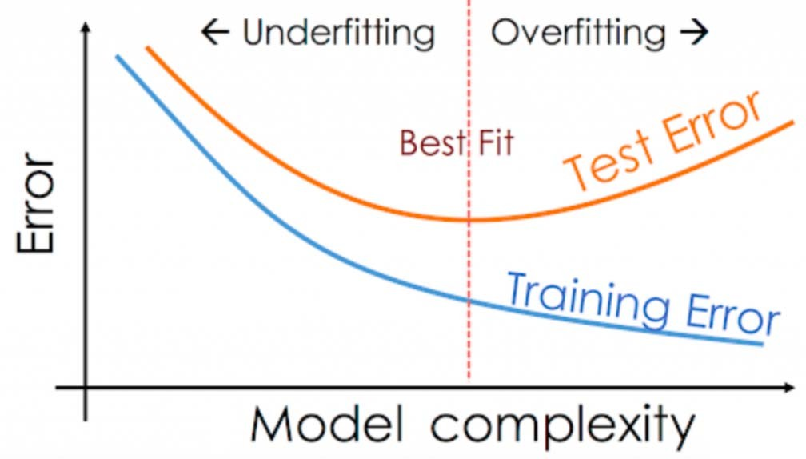
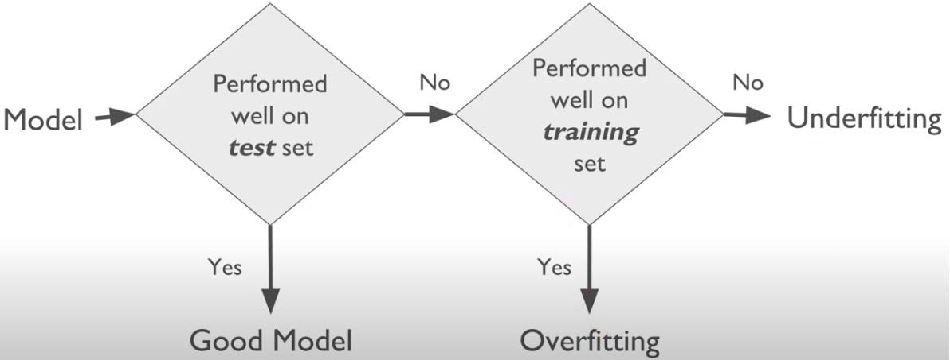
Overfitting and Underfitting

Slide 14
Prediction Error
Error for any supervised ML model comprises of three components:
Bias error
Variance error
Noise ‐ irreducible error, cannot be eliminated

Slide 15
Bias and Variance
Bias
Difference between model’s expected predictions and the true values
Error when the approximated function is trivial for a very complex problem, ignoring structural relationship between the predictors and the target (assumptions made by a model to make a function easier to learn)
High bias results in underfitting and a higher training error
Can be reduced by augmenting features which better describe the association with target variable
Variance
Extent to which the approximated function learned by a model differs a lot between different training sets (sensitivity to specific sets of training data)
Model takes into account the fluctuations in the data, i.e., learns the noise as well (model is specific to the data on which it was trained, not applicable to different datasets)
Due to inability to perfectly estimate parameters from limited data
High variance results in overfitting
Regularization, simpler classifier, more training data to control the variance

Slide 16
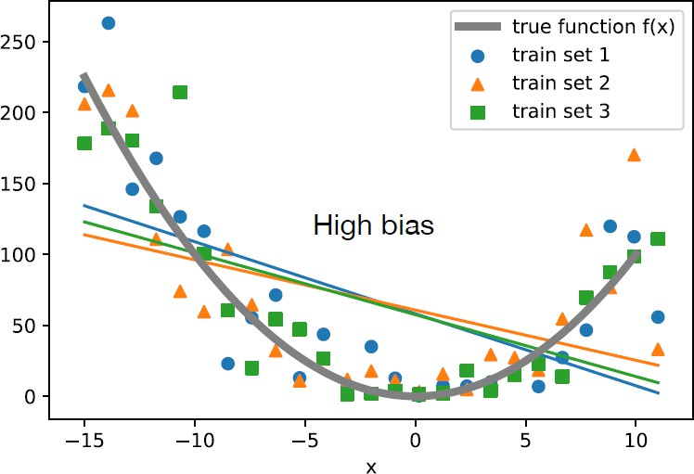
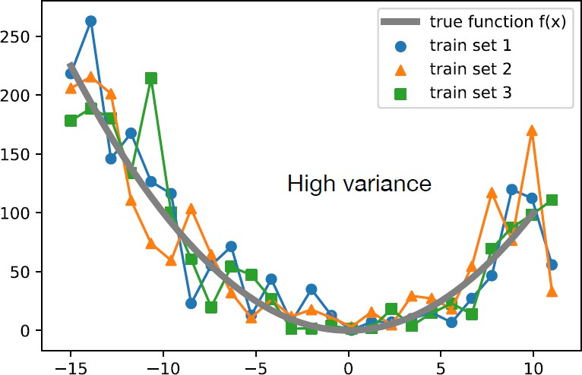
Bias and Variance
Assume an unknown target function or “true function” which we want to approximate
Consider different training sets drawn from an unknown distribution defined as “true function + noise”
f(x)
f(x)
Plot shows different unpruned decision tree models, each fit to a different training set
Models fit the training data very closely
The average hypothesis, the expectation over training
sets, would fit the true function perfectly (given that the noise is unbiased and has an expected value of 0)
However, the variance is very high, since on average, a prediction differs a lot from the expected value of the prediction
Plot shows different linear regression models, each fit to a different training set
None of these models approximate the true function well, except at two points (around x=‐10 and x=6)
Bias is large because the difference between the true value and the predicted value, on average is large

Slide 17
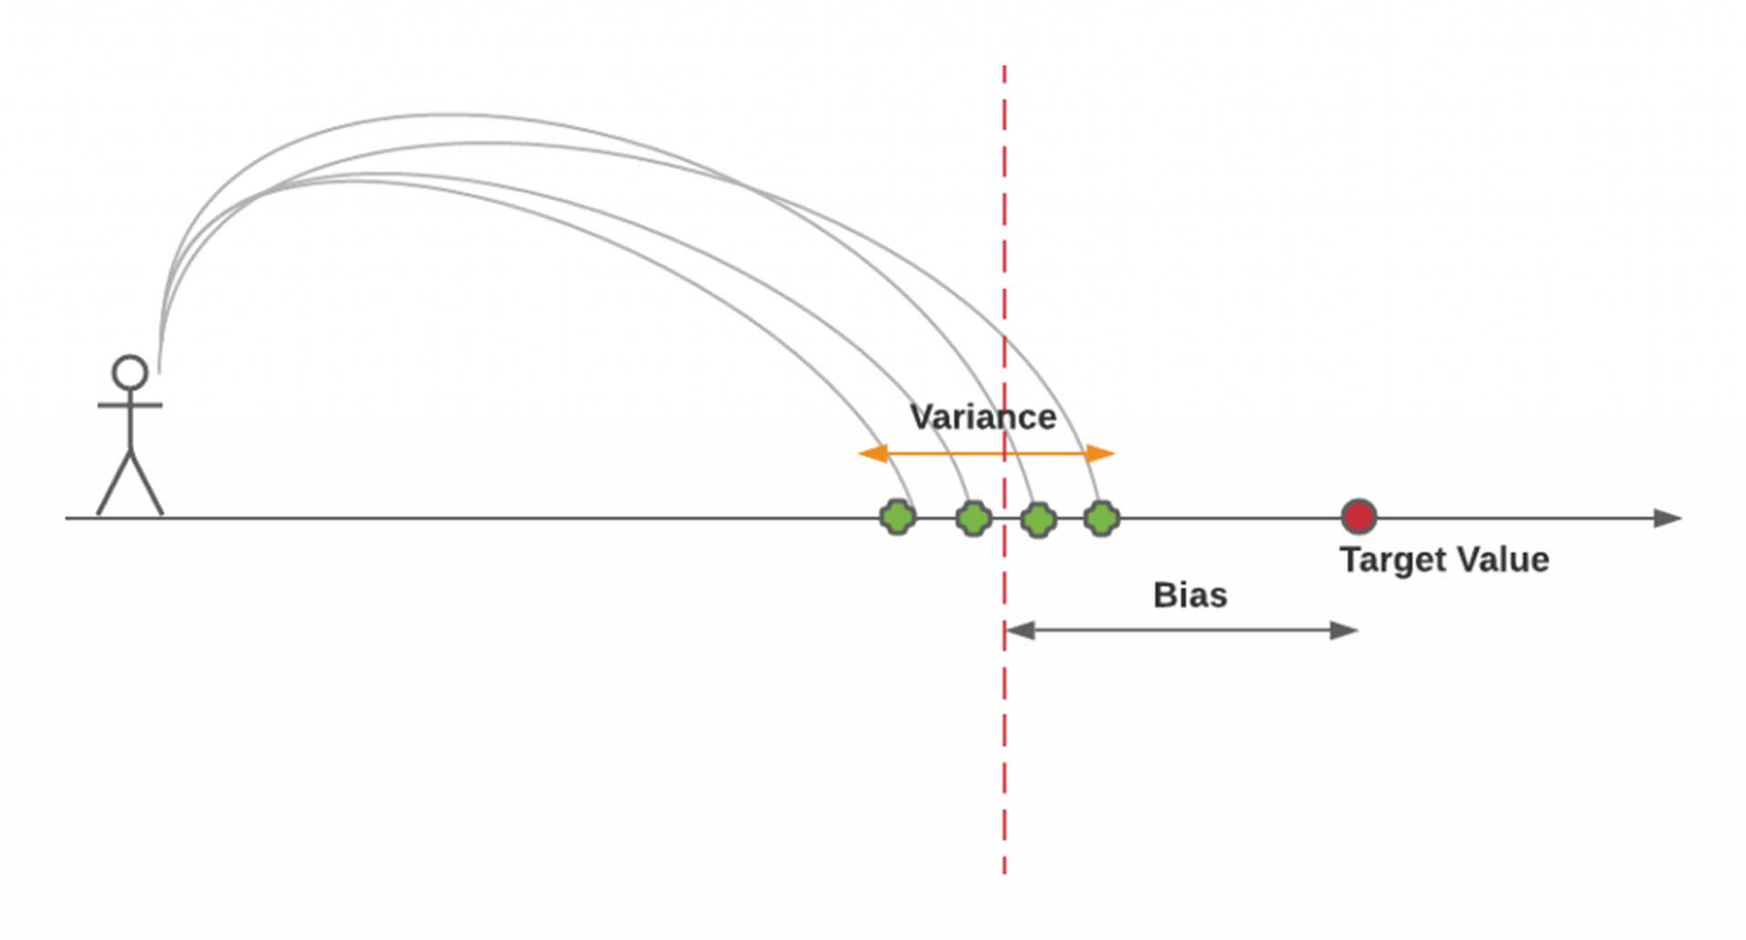
Bias and Variance

Slide 18
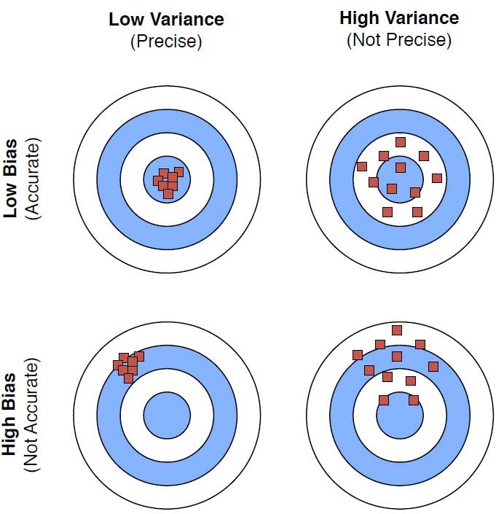
Bias and Variance
Overfitting
model is accurate on average, but inconsistent
Underfitting
model is consistent, but inaccurate on average
Source: https://sebastianraschka.com/pdf/lecture‐notes/stat479fs18/08_eval‐intro_notes.pdf

Slide 19
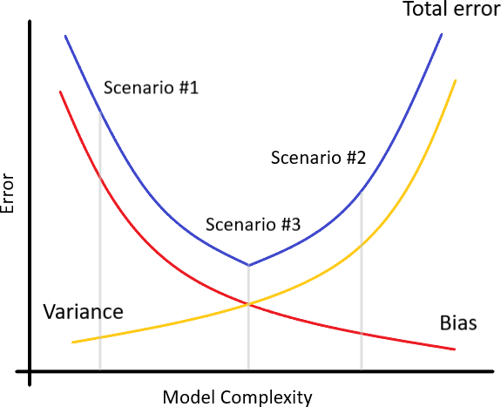
Bias‐Variance Tradeoff
Find a balance between bias and variance that minimizes the total error
Ensemble and cross validation are frequently used methods to minimize the total error
Scenario #1: High Bias, Low Variance ‐ underfitting
Scenario #2: Low Bias, High Variance ‐ overfitting
Scenario #3: Low Bias, Low Variance ‐ optimal state
Scenario #4: High Bias, High Variance ‐ something wrong with data (training and validation distribution mismatch, noisy data etc.)

Slide 20
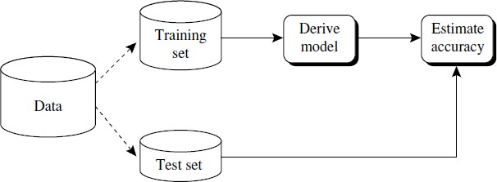
Accuracy Estimation
Holdout method
Given data are randomly partitioned into two independent sets, a
training set and a test set
Typically, two‐thirds of the data are allocated to the training set, and the remaining one‐third is allocated to the test set
Random subsampling
A variation of the holdout method
Holdout method is repeated k times
Overall accuracy estimate is taken as the average of the accuracies obtained from each iteration

Slide 21
Accuracy Estimation
k‐fold cross‐validation
Initial data are randomly partitioned into k mutually exclusive subsets or “folds,” D₁,D₂,…,D_{k}, each of approximately equal size
Training and testing is performed k times
In iteration i, partition D_{i} is reserved as the test set, and the remaining partitions are collectively used to train the model
In the first iteration, subsets D₂, …, D_{k} collectively serve as the training set to obtain a first model, which is tested on D₁
Unlike the holdout and random subsampling methods, here each sample is used the same number of times for training and once for testing
Accuracy estimate is the overall number of correct classifications from the k iterations, divided by the total number of tuples in the initial data

Slide 22
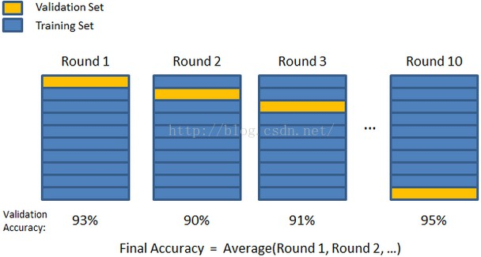
Accuracy Estimation
k‐fold cross‐validation

Slide 23
Techniques to Improve Classification Accuracy
Ensemble methods
a composite model (combination of classifiers) to obtain better predictive performance than could be obtained from any of the constituent classifiers alone
more accurate than their component classifiers
Reliability of a single algorithm is often not sufficient
Algorithms can be used with different parameters, which have different effects in certain data situations
Certain algorithms are prone to underfitting, others to overfitting
Different weaknesses of all algorithms hopefully should cancel each other out
Individual classifiers vote, and a class label prediction is returned by the ensemble based on the collection of votes
Ensemble methods also used for regression
Averaging results of individual regressors

Slide 24



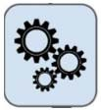



Ensemble Methods
D
Original Training Set
Step 1:
Create Multiple Data Sets
D₁
D₂
…….
^{D}t‐1
D_{t}
Step 2:
Build Multiple Classifiers
Step 3: Combine Classifiers

Slide 25
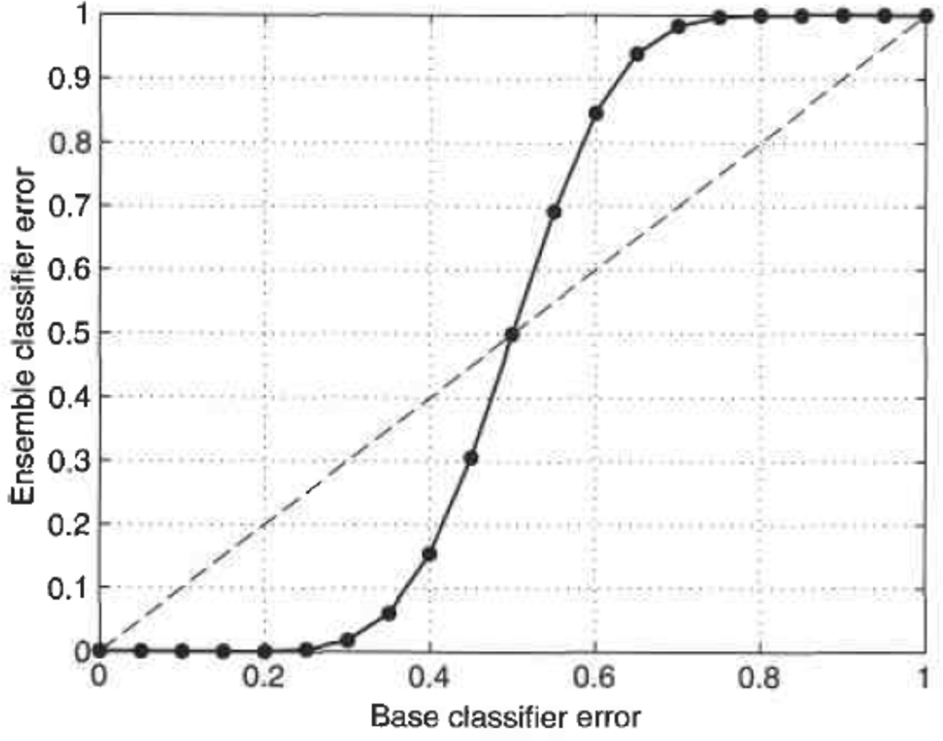
Ensemble Methods
Necessary conditions for an ensemble classifier to perform better than a single classifier:
the base classifiers should be independent of each other, and
the base classifiers should do better than a classifier that performs random guessing
Figure shows error rate of an ensemble of 25 binary classifiers for different base classifier error rates
Diagonal line represents the case where the base classifiers are identical
Solid line represents the case in which the base classifiers are independent
Ensemble classifier performs worse than the base classifiers when base classifier error rate is larger than 0.5

Slide 26
Ensemble Methods
Two families of ensemble methods
Averaging methods
Build several estimators independently and then average their predictions
Variance of the combined estimator is reduced
Examples: Bagging methods, Forests of randomized trees, …
Boosting methods
Base estimators are built sequentially
Bias of the combined estimator is reduced
Examples: AdaBoost, Gradient Tree Boosting, …

Slide 27
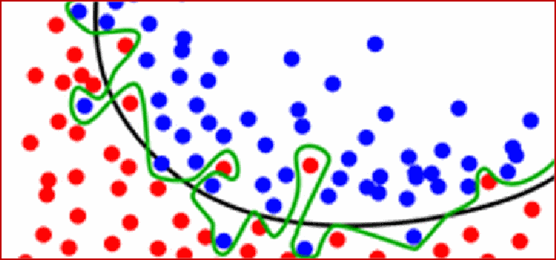
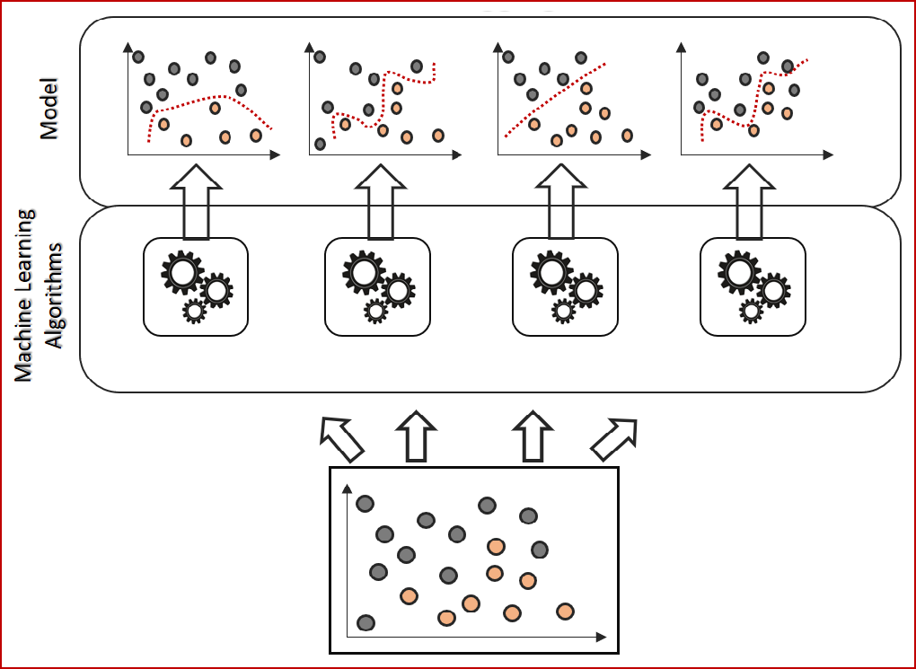
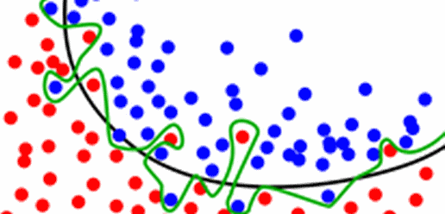
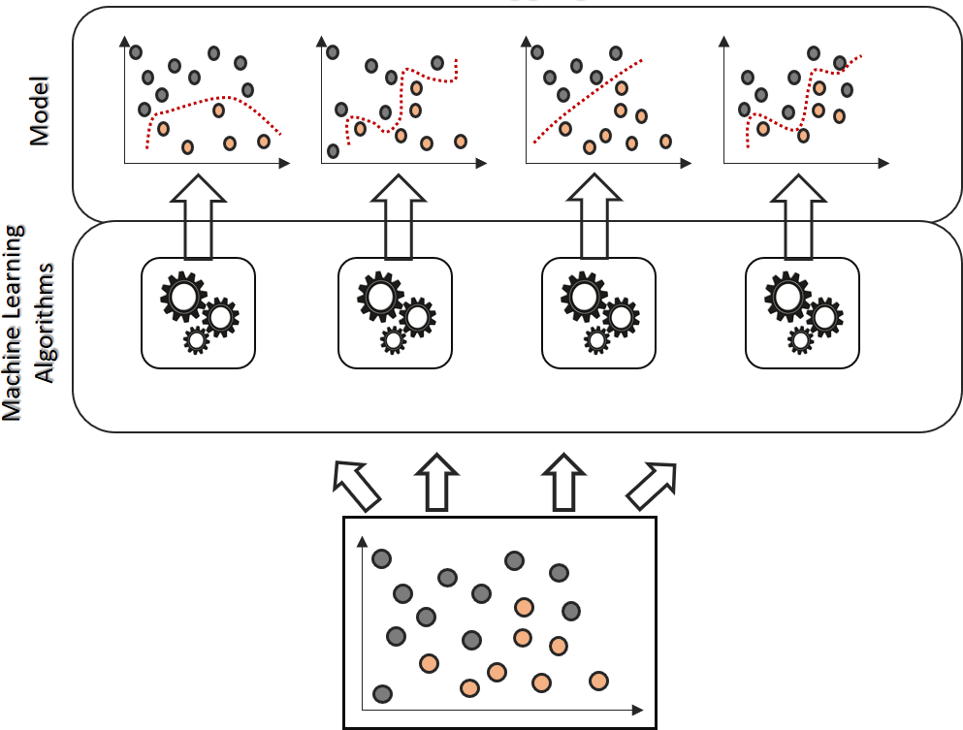
Ensemble Methods
Bagging
Robust to the effects of noisy data and overfitting
Works best with strong and complex models (e.g., fully developed decision trees)
If base classifier has poor performance, Bagging will rarely get a better bias
A single model’s predictions (green line) can be a little rough around the edges
Green line has learned from noisy datapoints
Black line shows a better separation than the green line
Averaging multiple different green lines should bring us closer to the black line
If difficulty of the base classifier is over‐fitting (unstable, high variance), Bagging is the best option

Slide 28

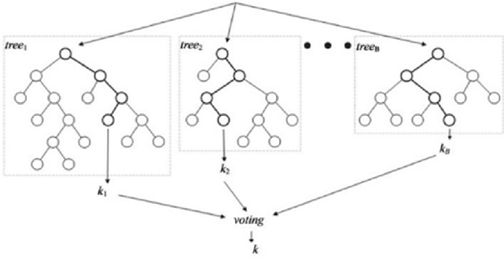
Ensemble Methods
Random Forests
each of the classifiers in the ensemble is a decision tree classifier
individual decision trees are generated using a random selection of attributes at each node to determine the split
the number of attributes to be used to determine the split at each node is much smaller than the number of available attributes
Forest‐RI (random input selection)
D

Slide 29
Ensemble Methods
Random Forests
Forest‐RC: uses random linear combinations of the input attributes
Creates new attributes (or features) that are a linear combination of the existing attributes
useful when there are only a few attributes available, so as to reduce the correlation between individual classifiers
Comparable in accuracy to AdaBoost, yet are more robust to errors and outliers
Overfitting is not a problem
Insensitive to the number of attributes selected for consideration at each split
Efficient on large databases since many fewer attributes considered for each split
Provide internal estimates of variable importance

Slide 30
Ensemble Methods
Boosting and AdaBoost (Adaptive Boosting)
Sequential Ensemble Learning
Fit a sequence of weak learners (models that are only slightly better than random guessing, such as small decision trees) on repeatedly modified versions of the data
Predictions from all classifiers are combined through a weighted majority vote (or sum) to produce the final prediction
Weight of each classifier is a function of its accuracy
Weights are also assigned to each training tuple
After a classifier, M_{i} , is learned, the weights of the tuples are updated to allow the subsequent classifier,M_{i+1}, to “pay more attention” to the training tuples that were misclassified by M_{i}

Slide 31
Ensemble Methods
Boosting and AdaBoost (Adaptive Boosting)
If a tuple was incorrectly classified, its weight is increased
If correctly classified, its weight is decreased
A tuple’s weight reflects how difficult it is to classify—the higher the weight, the more often it has been misclassified
A series of classifiers that complement each other
New classifiers influenced by performance of previously built classifiers
If classifier is stable and simple (high bias), apply Boosting

Slide 32
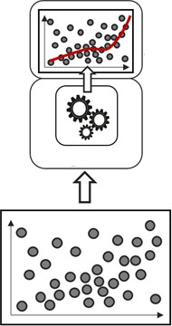
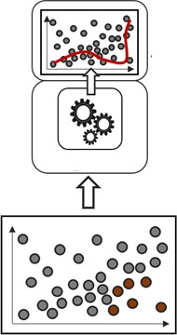
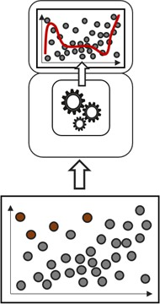
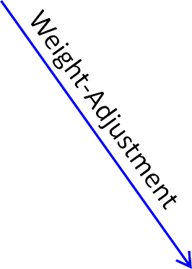
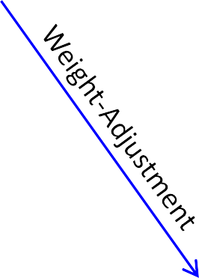
Ensemble Methods
Boosting and AdaBoost

Slide 33
Class‐Imbalanced Data
How to improve the classification accuracy of class‐ imbalanced data?
Oversampling: resamples the positive tuples so that the resulting training set contains an equal number of positive and negative tuples
Undersampling: randomly eliminates tuples from the majority (negative) class until there are an equal number of positive and negative tuples
SMOTE (synthetic minority oversampling technique): uses oversampling where synthetic tuples are added, which are “close to” the given positive tuples in tuple space

Slide 34
Class‐Imbalanced Data
Example. Suppose the original training set contains 100 positive and 1000 negative tuples
In oversampling, tuples of the rarer class are replicated to form a new training set containing 1000 positive tuples and 1000 negative tuples
In undersampling, negative tuples are randomly eliminated so that the new training set contains 100 positive tuples and 100 negative tuples

Slide 35
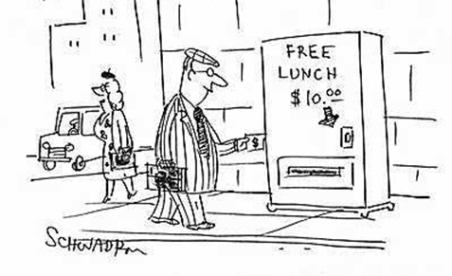
What to Remember?
No free lunch: machine learning algorithms are tools, not dogmas
No Free Lunch Theorem for Machine Learning (Wolpert and Macready, 1997)
You cannot gain something from nothing; even if something appears to be free, there is always a cost
If an algorithm performs better than random search on some class of problems, then it must perform worse than random search on the remaining problems
No classifier is inherently better than any other
Try simple classifiers first
Better to have smart features and simple classifiers than simple features and smart classifiers
Use increasingly powerful classifiers with more training data (bias‐variance tradeoff)

